Slide 1
Introduction to R and R Studio
Session 1
August 16, 2020

Slide 2
August 16 2020 | Session | Instructor
9:00 am - 9:30 am | Instructor Introductions, Introduction to technology | Amrom Obstfeld
9:30 am - 10:15 am | Introduction to R and RStudio | Amrom Obstfeld
10:30 pm - 11:15 am | Reproducible Reporting | Amrom Obstfeld
11:30 am - 1:00 am | Data Visualization | Stephan Kadauke
August 23 2020
9:00 am - 10:30 pm | Data Transformation | Amrom Obstfeld
10:45 am - 12:15 pm | Statistical Analysis | Dan Herman
12:30 pm - 1:00 pm | Workshop Close out | Amrom Obstfeld

Slide 3
Lesson Goals
Get oriented to R and RStudio
Learn some fundamentals of coding
Lesson Objectives
Log in and tour RStudio Cloud
Execute code at the console
Define and use functions
Define and create objects in the environment
Load data into R and interact with a dataframe
Notes:
In this first session our goal is to develop some familiarity with the R programming language as well as some basic proficiency with coding fundamentals as they are implemented in R.
We will log into the R environment and learn about the how to execute code in the console.
Upon this we will layer concepts of functions and objects. We will use some basic functions and make some objects.
Finally we will load data and interact with a dataframe.

Slide 4
Getting Oriented to R

Slide 5
What is R?
R is a statistical programming language.
Using R you can load, analyze, and visualize data.
R also provides an environment in which we can conduct reproducible data analysis.
Documented
Revisable
Shareable
Notes:
R is a statistical programming language. It is freely available and has been evolving for > 25 years.
R is popular with statisticians and data analysts. It’s flexible, extensible, and broadly capable for the import, analysis, and visualization data.
R supports everything from linear regression to machine learning to dashboard development.
R also enables us to conduct reproducible analysis that we can document, iterate, and share with colleagues. R is great for those looking to graduate from working with spreadsheets.

Slide 6
RStudio: The Portal to R
RStudio is an integrated development environment (IDE)
Using RStudio we can interact with the R programming language to:
Write and execute code interactively
View data
Debug and fix errors
Author our code
Notes:
A base install of R gives us the ability to write and execute code.
However, many R users choose to leverage an integrated development environment (IDE) for their work in addition to the base install. An IDE layers over the R programming language and provides a more streamlined way for us to work with R.
The most popular R IDE is RStudio. This is the IDE we will be using in this course. RStudio is also a company (the that produces the RStudio IDE). In this course, when we say RStudio, we are referring to the IDE software.
RStudio adds many features to the basic R installation including the ability to easily view data, identify syntax (code grammar), and debug our code to fix errors.

Slide 7

RStudio: In the Cloud… In Your Home
RStudio Cloud: An online hosted version of RStudio that we will use for these course sessions
RStudio Desktop: A locally installed version of RStudio that you will use when you get home to continue your learning
Note: Use Rstudio Cloud only for this course. Do not upload protected health information to the cloud!
Notes:
For today’s course we plan to leverage RStudio Cloud. RStudio Cloud is an internet hosted version of RStudio which allowed us to prepare an environment and prepopulate it with data, code, and exercises so you don’t have to spend your energy on those pieces.
When you get home, you will likely transition to using a RStudio Desktop which is a locally installed version of RStudio. We suggested that you install the desktop version ahead of this course so you will be ready to continue to learning R when you walk out of the classroom this afternoon and as a fallback in the event that we experience technical challenges with the cloud deployment.

Slide 8
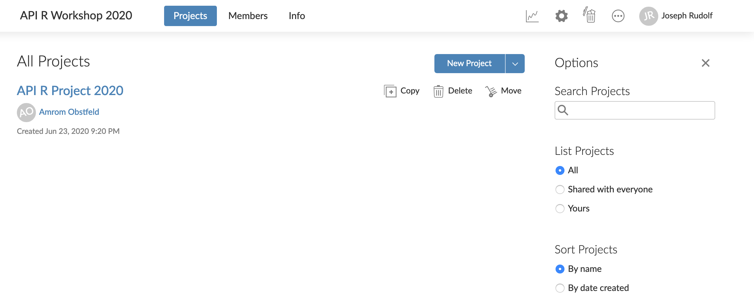
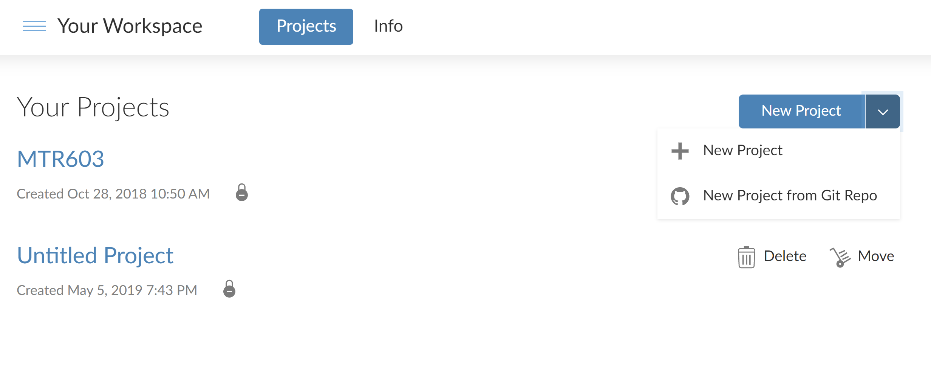
Your Turn
Navigate to: rstudio.cloud
Register for an account
Type in this link at the prompt: https://tinyurl.com/pennres2020
Notes:
Let’s take a few minutes to get logged into RStudio Cloud.
In the pre-course email, we asked you to create an RStudio log in. Use those credentials now to access the cloud instance.
The following slides show the clicks to copy the workspace.
When you are finished, go over to the participants window and raise your hand. If you get stuck, type your question in the chat window.

Slide 9
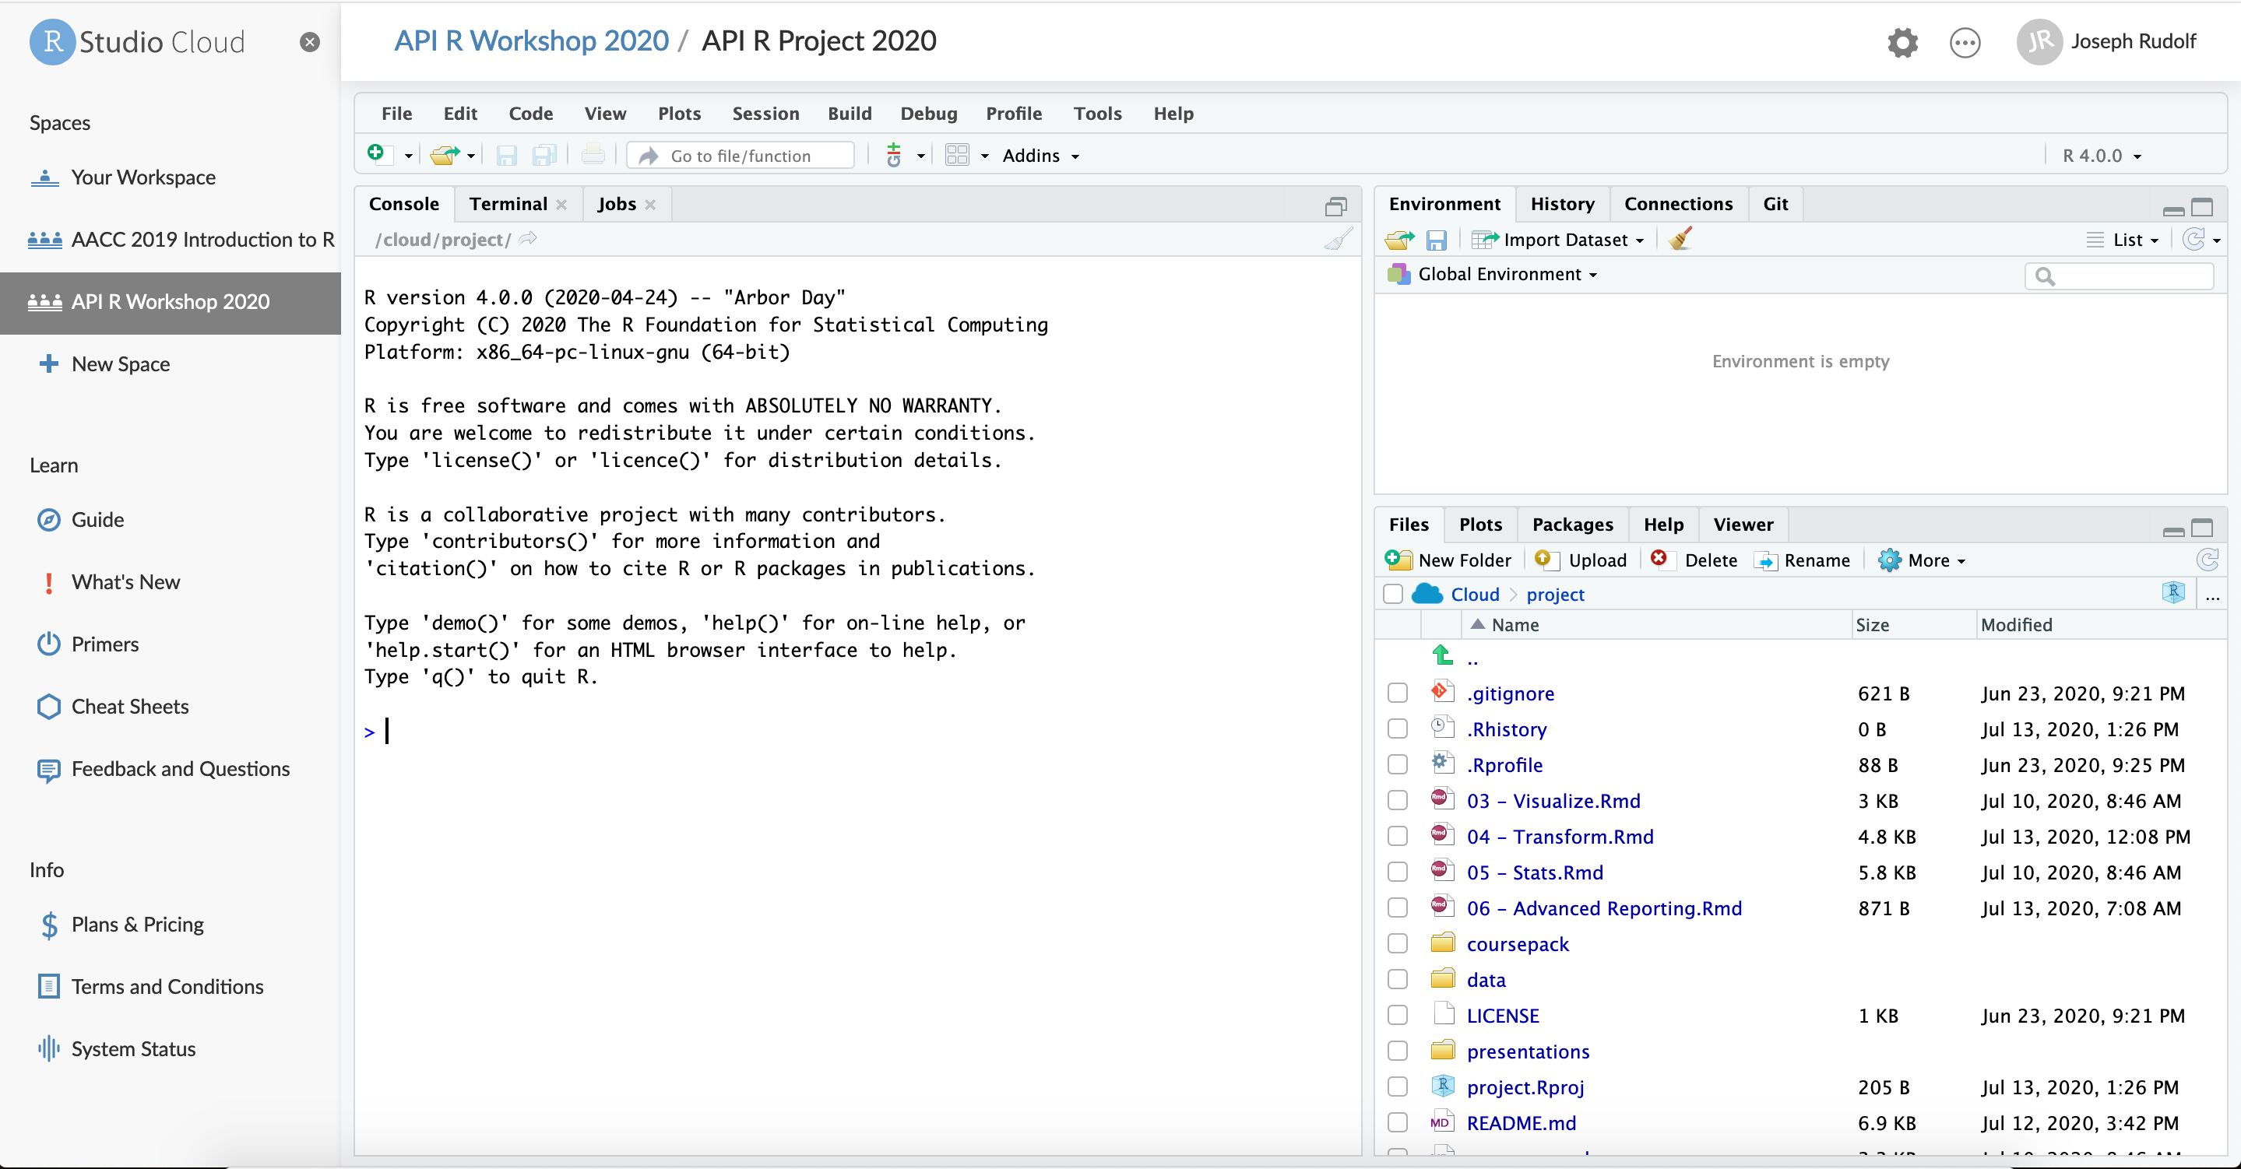
Notes:
Wait for for your version of the project to spin up.
Your screen will look like this when the work space is finished loading.

Slide 10
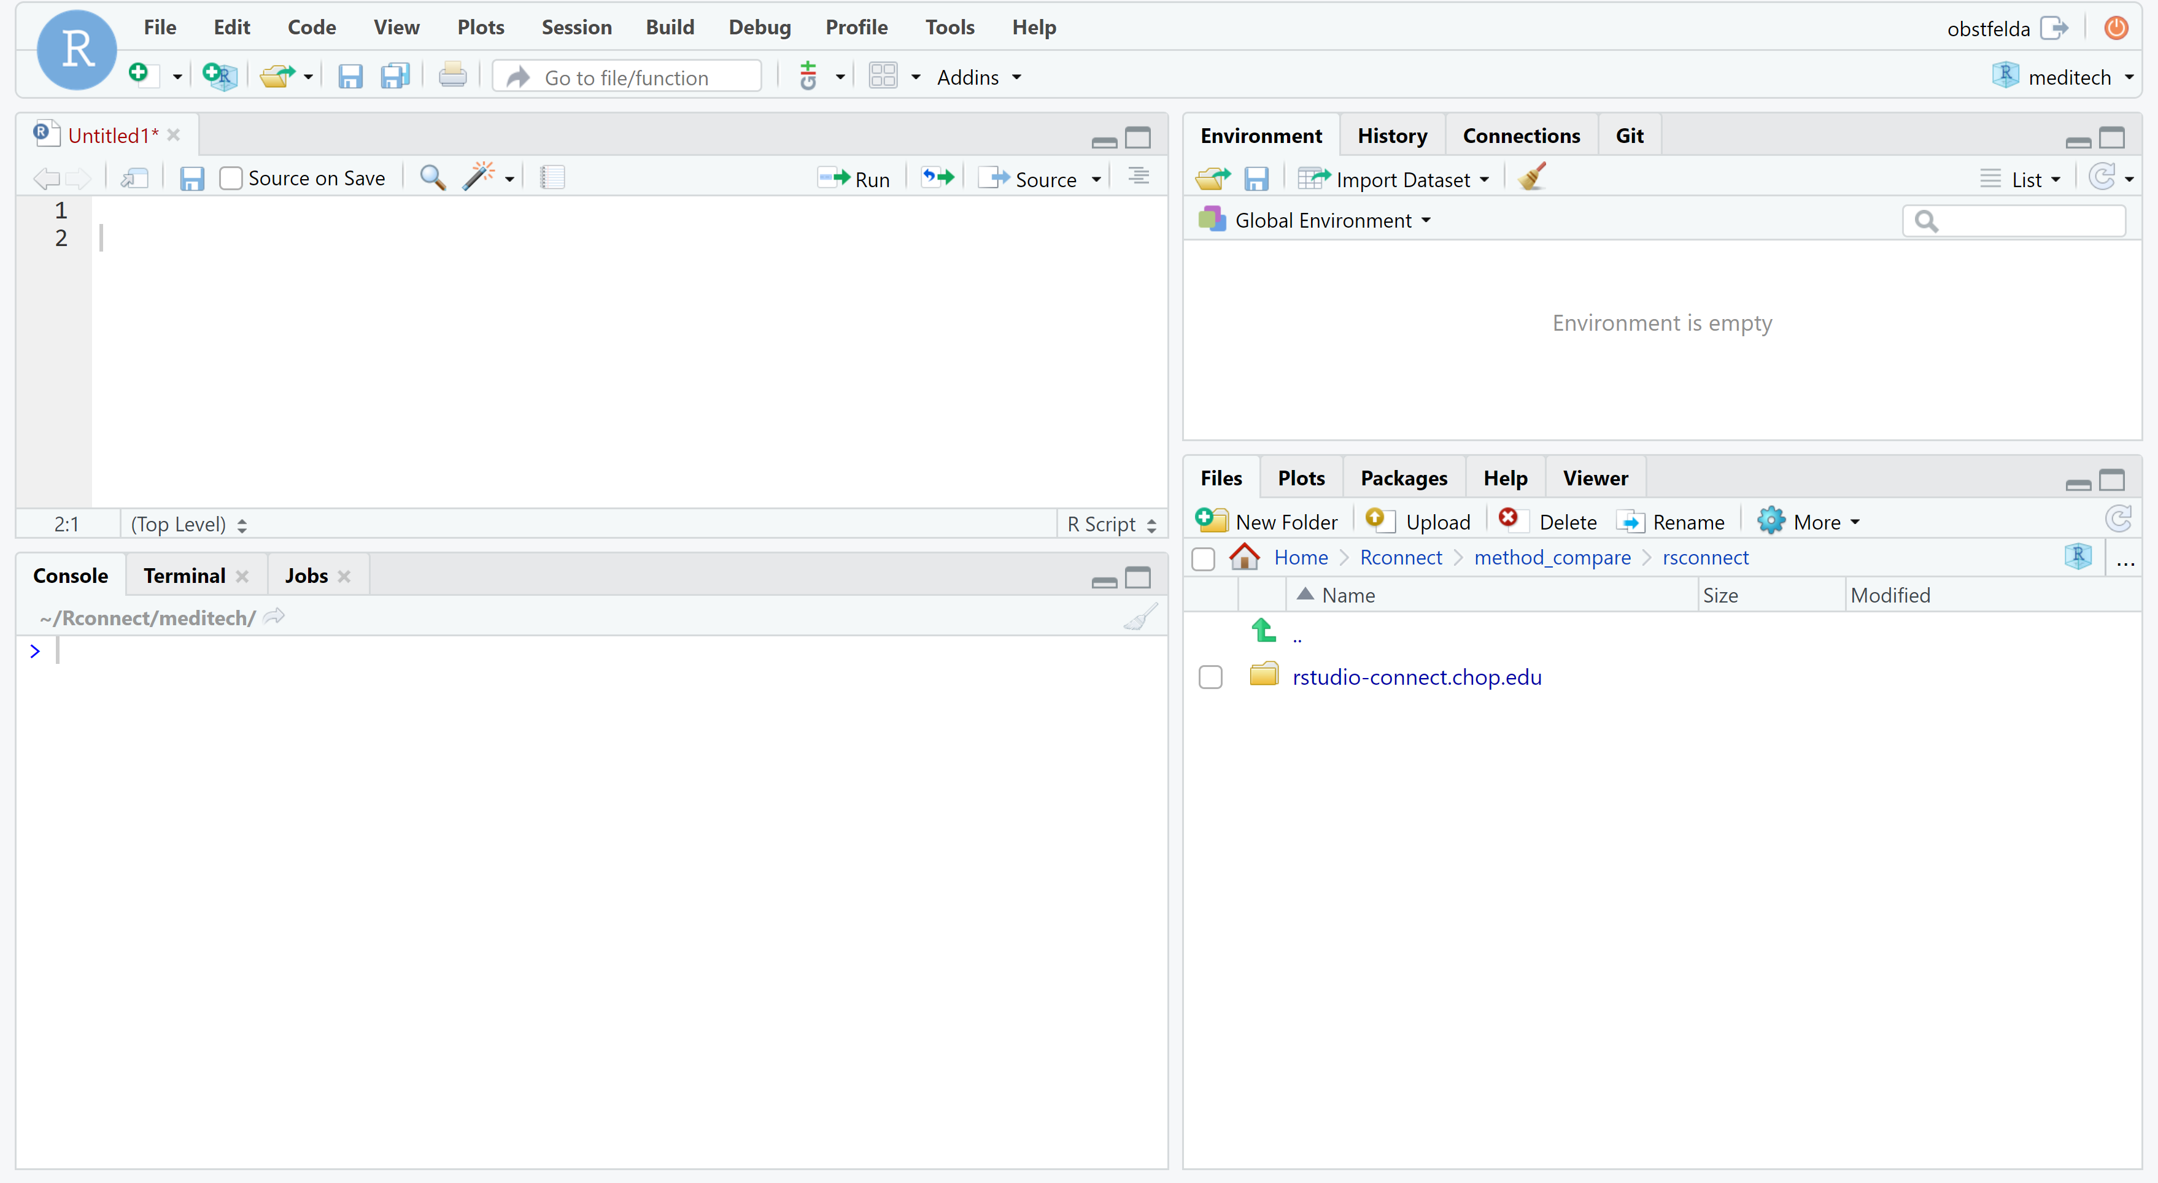
ENVIRONMENT
EDITOR
CONSOLE
MISC
Notes:
This is the basic RStudio layout.
Console – The “heart of R” is the Console window. This is where instructions are sent to R, and its responses are given. The console is, almost exclusively, the way of talking to R in RStudio.
Environment – A virtual storage of all objects you create in R. So, for example, if you read in some data into R, this is where they will be put.
Misc window – Has a lot useful tabs, right now it's open to the active directory on the computer. There area also tabs for plots and other useful things.
Editor - This is where you compose R script files. Each script, when saved, is just a text file with some added bells and whistles. There’s nothing special about it. If you wanted to, you could write your script in NotePad, save it, change its extension from .txt to .R and open it in Rstudio.

Slide 11
The Basics of Coding

Slide 12
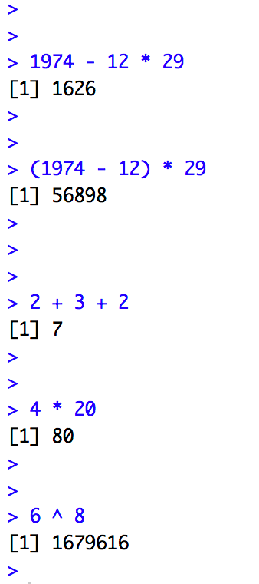
The Basics of Coding: Calculation
R is a calculator!
enter/return to execute code
answer returned here
Notes:
At it’s most basic, R is a fancy calculator.
It supports common mathematical operators
+ add, - subtract
* multiply, / divide
^ exponents
We type our code at the console and use the enter (return) key to execute.
The answer is returned on the following line.

Slide 13
Your Turn #1
Place your cursor at the console and click to enter the console.
Complete the following calculation:
-For the date 12-29-1974
-Take the four digit year
-Subtract the month then multiply by the day
Notes:
Now it’s your turn to do some coding.
Complete the following exercise.
Did you get a 4 digit number, or a 5-digit number as your result?

Slide 14
What did you get?
A four digit number? A five digit number?
Order of operations matters!
Notes:
Let’s review our answers.
Order of operations matters
exponents and roots first
multiplication and division
addition and subtraction
Multiplication will occur before subtraction unless we embed our operation in parentheses.

Slide 15
The Basis of Coding: 3 Players
1. Functions
2. Arguments
3. Objects

Slide 16
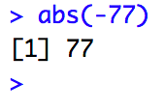
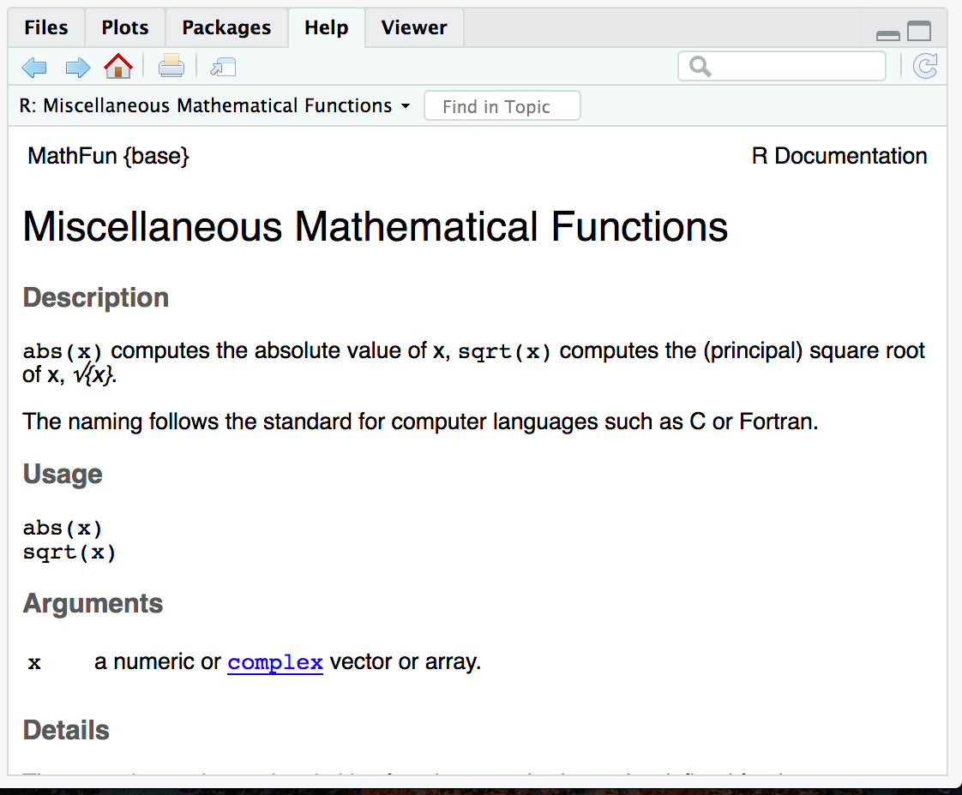
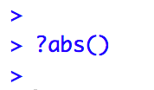
The Basics of Coding: Functions
function
(does stuff)
Code that extends our reach beyond the basic operators
What if I don’t know what a function does?
abs(-77 )
Notes:
Functions are code that perform actions on our behalf. We can use functions that others have written (or that we write ourselves) to reuse existing code over and over.
Then the function does its task and provides us with some output, in this case the absolute value of an integer.
The help feature in R is very… helpful! Preceding a function with ? and executing the line will bring up help documentation and will educate us on how to use a function.

Slide 17
The Basics of Coding: Arguments
argument
(input)
The input that defines what the function should do
abs(-77 )
Notes:
Functions accept an argument (input). We use parentheses as the syntax (grammar) to identify the argument(s).

Slide 18
The Basics of Coding: Objects
Objects are the container for your output
object
(stores output)
my_abs <- abs(-77 )
Notes:
Objects are a very important concept in many programming language.
Objects are the containers in which we can store things for later use.
You can store single values, series, tables, or even text.
In this example we are taking our previous abs() ersult and storing it out to an object which we have called my_abs.
The <- characters are called an assignment operator. They point to the place where we want to store output.

Slide 19
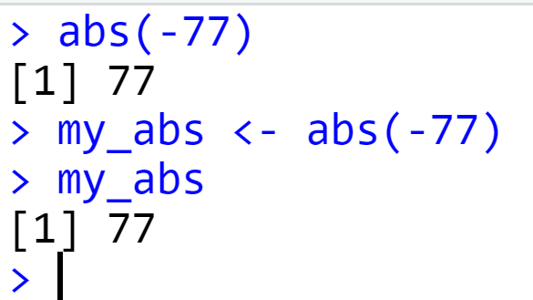
Checking the contents of an object
Entering the object name at the console allows us to output the contents of an object.
Notes:
We can call our object at the console by typing the object name and pressing enter/return.
You can execute code without assigning it to an object however the output is not stored for future use. If you want to revisit or reference the output of a particular line of code, assign it to an object using the assignment operator <-

Slide 20
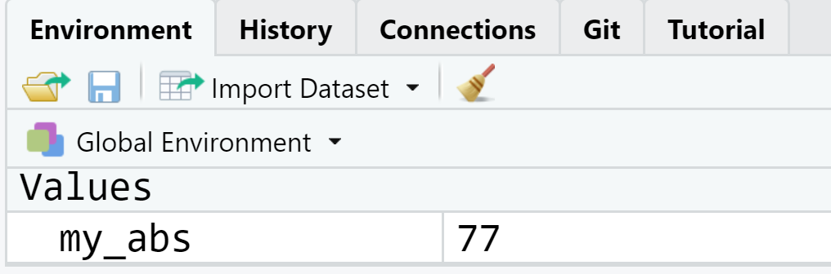
Checking the contents of an object
The environment tab shows us the objects we have created.
Notes:
We can also review our object in RStudio via the environment tab.
When we create an object in the environment, it will appear in the environment tab and we can review its contents there.

Slide 21
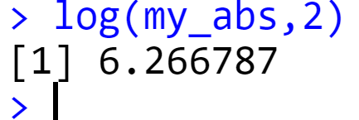
Bending objects to your will
Once we have created an object we can start to interact with it.
This includes passing our objects to other functions… Whoa!
Notes:
Objects are subject to same laws of programming we have learned so far.
We can provides objects as arguments for functions.

Slide 22
Knowledge Check
Consider this code:.
Which is the function?
Which is the argument?
Which is the objects?
mean_age <- mean(age, na.rm=TRUE)

Slide 23
The Basics of Coding: Packages
A package is a collection of functions.
Packages extend the capabilities of the base R programming language.
The tidyverse includes functions for reading data into the R environment, cleaning and manipulating data, and plotting our results.
Notes:
One of the features that makes R powerful is the fact that it’s easy to extend its functionality with packages.
A package is a essentially a zip file that contains data sets, functions, and help files that document those data sets and functions. They are written and published by members of the R community.
Packages are hosted on The Comprehensive R Archive Network [CRAN] at https://cran.r-project.org/. There are are 10,000 packages in CRAN, wow!
The tidyverse is an example of a package. It includes specialized functions for reading data, cleaning, data, performing analysis, and visualizing results.
We will make extensive use of the tidyverse in today’s course and encourage you to use it in your own work.

Slide 24
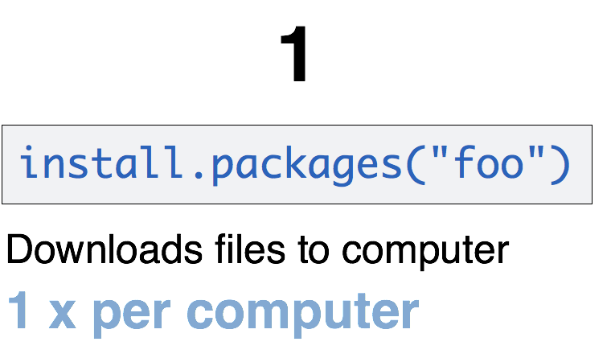
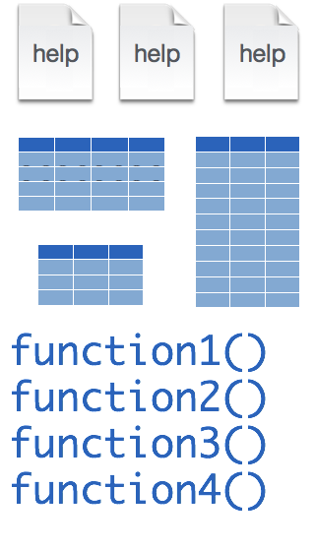
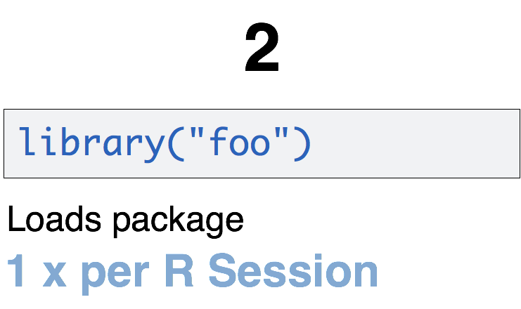
A Word About Packages
tidyverse
install.packages("tidyverse")
library("tidyverse")
CC BY-SA RStudio
Notes:
Packages need to be installed explicitly – with the command install.packages. So let’s say you want to install a package named “tidyverse”. You go to the R Console and type install.packages(“tidyverse”).
Each package you want to use needs to be installed only once on each computer. However, in order to use the functions or data in the package, you also need to load the package. This is done with the command “library”. So to enable all the functions in the “tidyverse” package, you type library(“tidyverse”). Packages remain loaded until you quit R. So every time you start a new R session you have to load each package that you want to use again.
On our RStudio Server, you won’t need to install any packages for this course. But at times you’ll need to load packages. We’ll practice this later.
So these are the first two R commands we’ve covered - install.packages and library.

Slide 25
Your Turn #2
Run the following in the console:
install.packages("tidyverse")
library("tidyverse")

Slide 26
The Data Analysis Process

Slide 27
Typical Data Analysis Pipeline
From R for Data Science (https://r4ds.had.co.nz/introduction.html)
Notes:
We refer to R for Data Science, a free text available online frequently
Provide a nice model for the typical process of analyzing data to communicate
Focus for this hour is the machinery that allows us to capture this whole process in a way that is reproducible and also can communicate to others

Slide 28
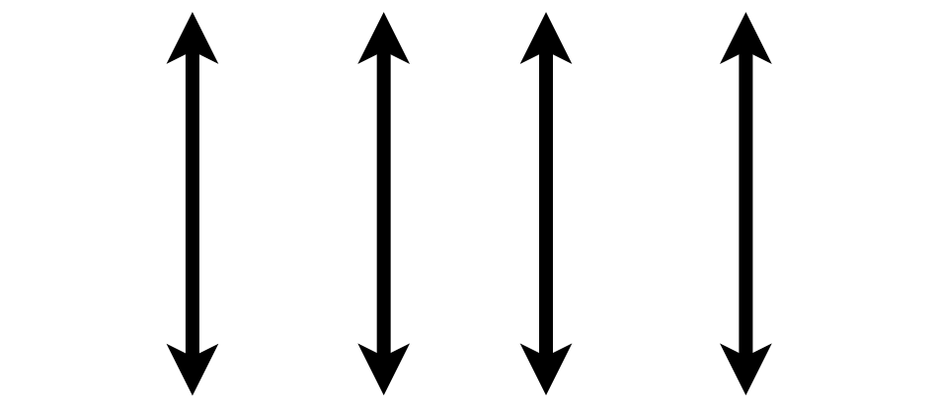

What is a “Tidy” Data Frame
A data set is tidy if:
Each variable is in its own column
Each observation is in its own row
Each value is in its own cell
MRN
Notes:
what do we mean by a tidy dataset. By definition it essentially describes a data set in which variables or features are recorded in columns →
Each row represents a single observation →
And finally each cell contains only one value.
This is admittedly somewhat abstract. The way that I think about it is that a tidy data set is one that is at the point where it is cleaned up and ready to be analyzed either using statistical analysis or through a visualization.
The opposite is a messy data frame which is generally how data will come at you in the wild and are difficult or impossible to analyze at the outset.

Slide 29
Importing Data

Slide 30
Typical Data Analysis Pipeline
Import
From R for Data Science (https://r4ds.had.co.nz/introduction.html)

Slide 31
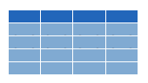


Dataframes: Beyond the Vector
Dataframe is the term for a table
Dataframes are composed:
Columns (Variables)
Rows (Observations)
Dataframes are objects and can be acted on like other objects
csv
xls
db
Notes:
Dataframe is the term we use for a table (think Excel spreadsheet).
Dataframes consists of columns (variables) and rows (observations). This is the tidy way to organize our data.
We can store dataframes as objects and perform actions on them like other objects.
We can get data into R from a variety of file formats (comma separated value files, excel spreadsheets, or directly from databases). This is the import part of data analysis.

Slide 32
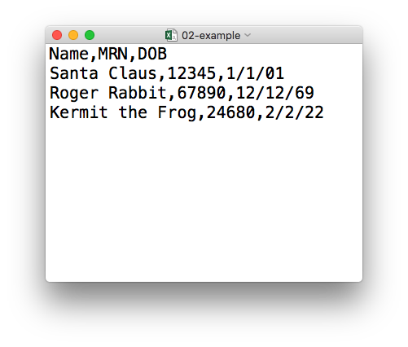
plain text (“flat”) file
rectangular structure
header row
Notes:
The data we will use for today’s course is in a file format called CSV. CSV stands for comma-separated values.
A CSV file is a plain text file, which means you can open it in a text editor and look at it.
Here we have a CSV file with the names, MRNs, and date of birth of three “patients”.
This data structure is called rectangular because it falls into rows and columns, where each row has the same # of columns, and each column has the same # of rows.
Also note that this particular CSV file has a header row that, instead of data, has a descriptor of what kinds of data are found in each column. CSV files often but not always have such a header row.

Slide 33
Loading Data to Create a Dataframe
data_frame <- read_csv("file_name")
csv
Notes:
You can import CSV files using this line of code.
Here is a template for how to use the read_csv function to create a dataframe object from a CSV file.

Slide 34
Memory Check
After reading in data using code such as this, where will you the data appear?
data_frame <- read_csv("file_name")
ENVIRONMENT
EDITOR
CONSOLE
MISC
Notes:
Let's see how well we remember

Slide 35
read_csv()
data frame to read data into
name of
CSV file
covid_testing <- read_csv(“data/covid_testing.csv”)
covid_testing
covid_testing.csv
csv
Notes:
So, for example in this line of code the object covid_testing gets a data frame created by read_csv as it reads a file named covid_testing.csv.
You might notice that the name of the file is in quotes.
To be honest, quotes can be confusing. Names of objects that have been loaded into R's memory such as data frames don't get quotes.

Slide 36
Your Turn #3
Configure environment and load the Covid Testing CSV:
Load the tidyverse library using library(tidyverse)
Use the read_csv() function to load the data
-File_name argument: “data/covid_testing.csv”
-Object name: covid_testing
Notes:
Your turn again!
Let’s load some data from a CSV file into a dataframe called covid_testing using the read_csv() function.
Don’t forget to load the tidyverse with library() function first if you haven’t loaded it already this session.

Slide 37
What’s in a name?
Capitalization matters
Strive for names that are concise and meaningful (not easy!)
covid_testing
≠
Covid_testing
≠
COVID_TESTING
Bad
Still not great
Good
p
name
patient_name
Notes:
Developing good naming conventions pays dividends!
Best practices for naming:
meaningful
concise
consistent
lower case
underscores between words

Slide 38
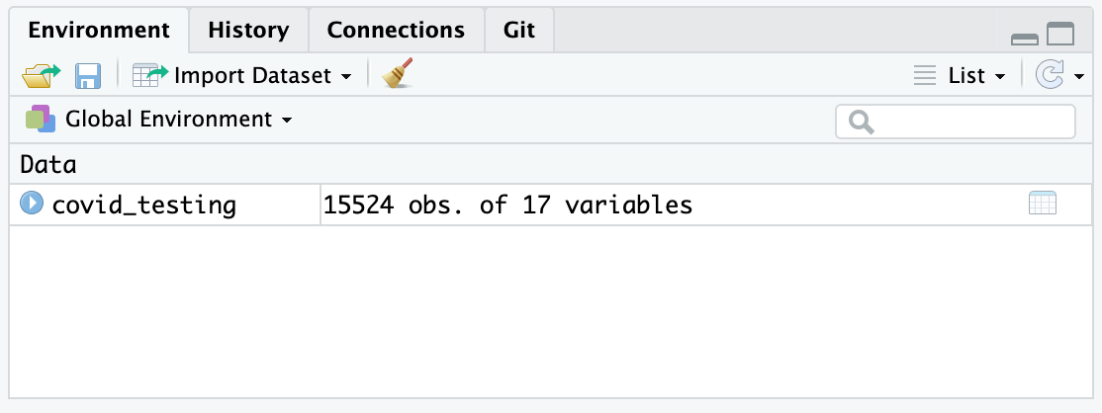
Viewing the Contents of a Dataframe
single click to explore the data
Notes:
To view the contents of an object, we can single click the name of the object in the environment tab.

Slide 39
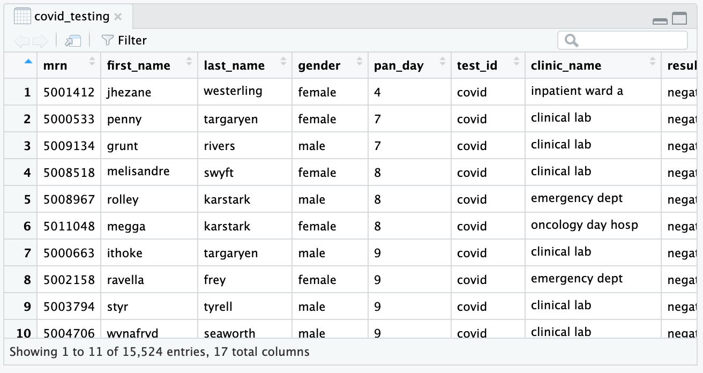
Viewing the Contents of a Dataframe
17 Attributes (Columns)
15,524 Observations (Rows)
Notes:
This data frame consists of 17 attributes (columns) and 15,524 observations (rows).
After exploring the data in the dataframe we can close it by selecting the “x” in the tab at the top left of the pane.

Slide 40
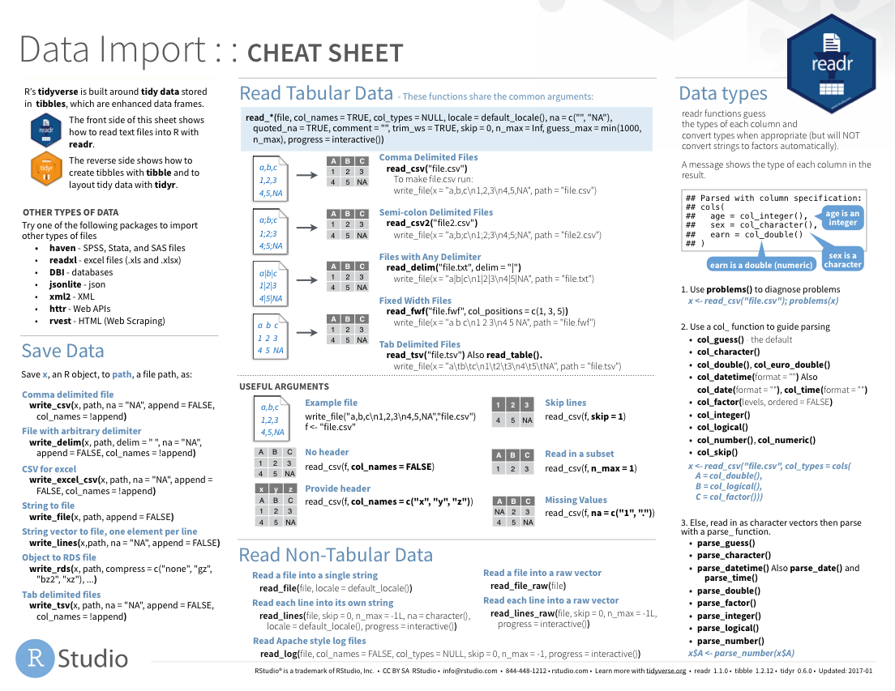
Notes:
The Data Import cheat sheet actually answers the question how to import pipe-delimited files.

Slide 41
What Else?
Notes:
Now that you’ve learned to create some basic plots that can be embedded into your R Markdown document we’ll wrap up experimenting with other document types

Slide 42
Import Excel files
(.xls, .xlsx)
library(readxl)
Notes:
For importing Excel files, we load the readxl package using the command library(readxl).

Slide 43
read_excel()
data frame to read data into
name of
Excel file
data_frame <- read_excel(file_name)
xls
Notes:
The function for importing an Excel file is called read_excel. It works exactly like the read_csv function.

Slide 44
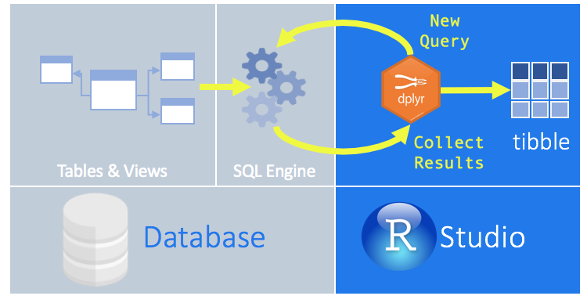
Read Directly From Database

Slide 45

Reads SPSS, Stata, and SAS files

Slide 46
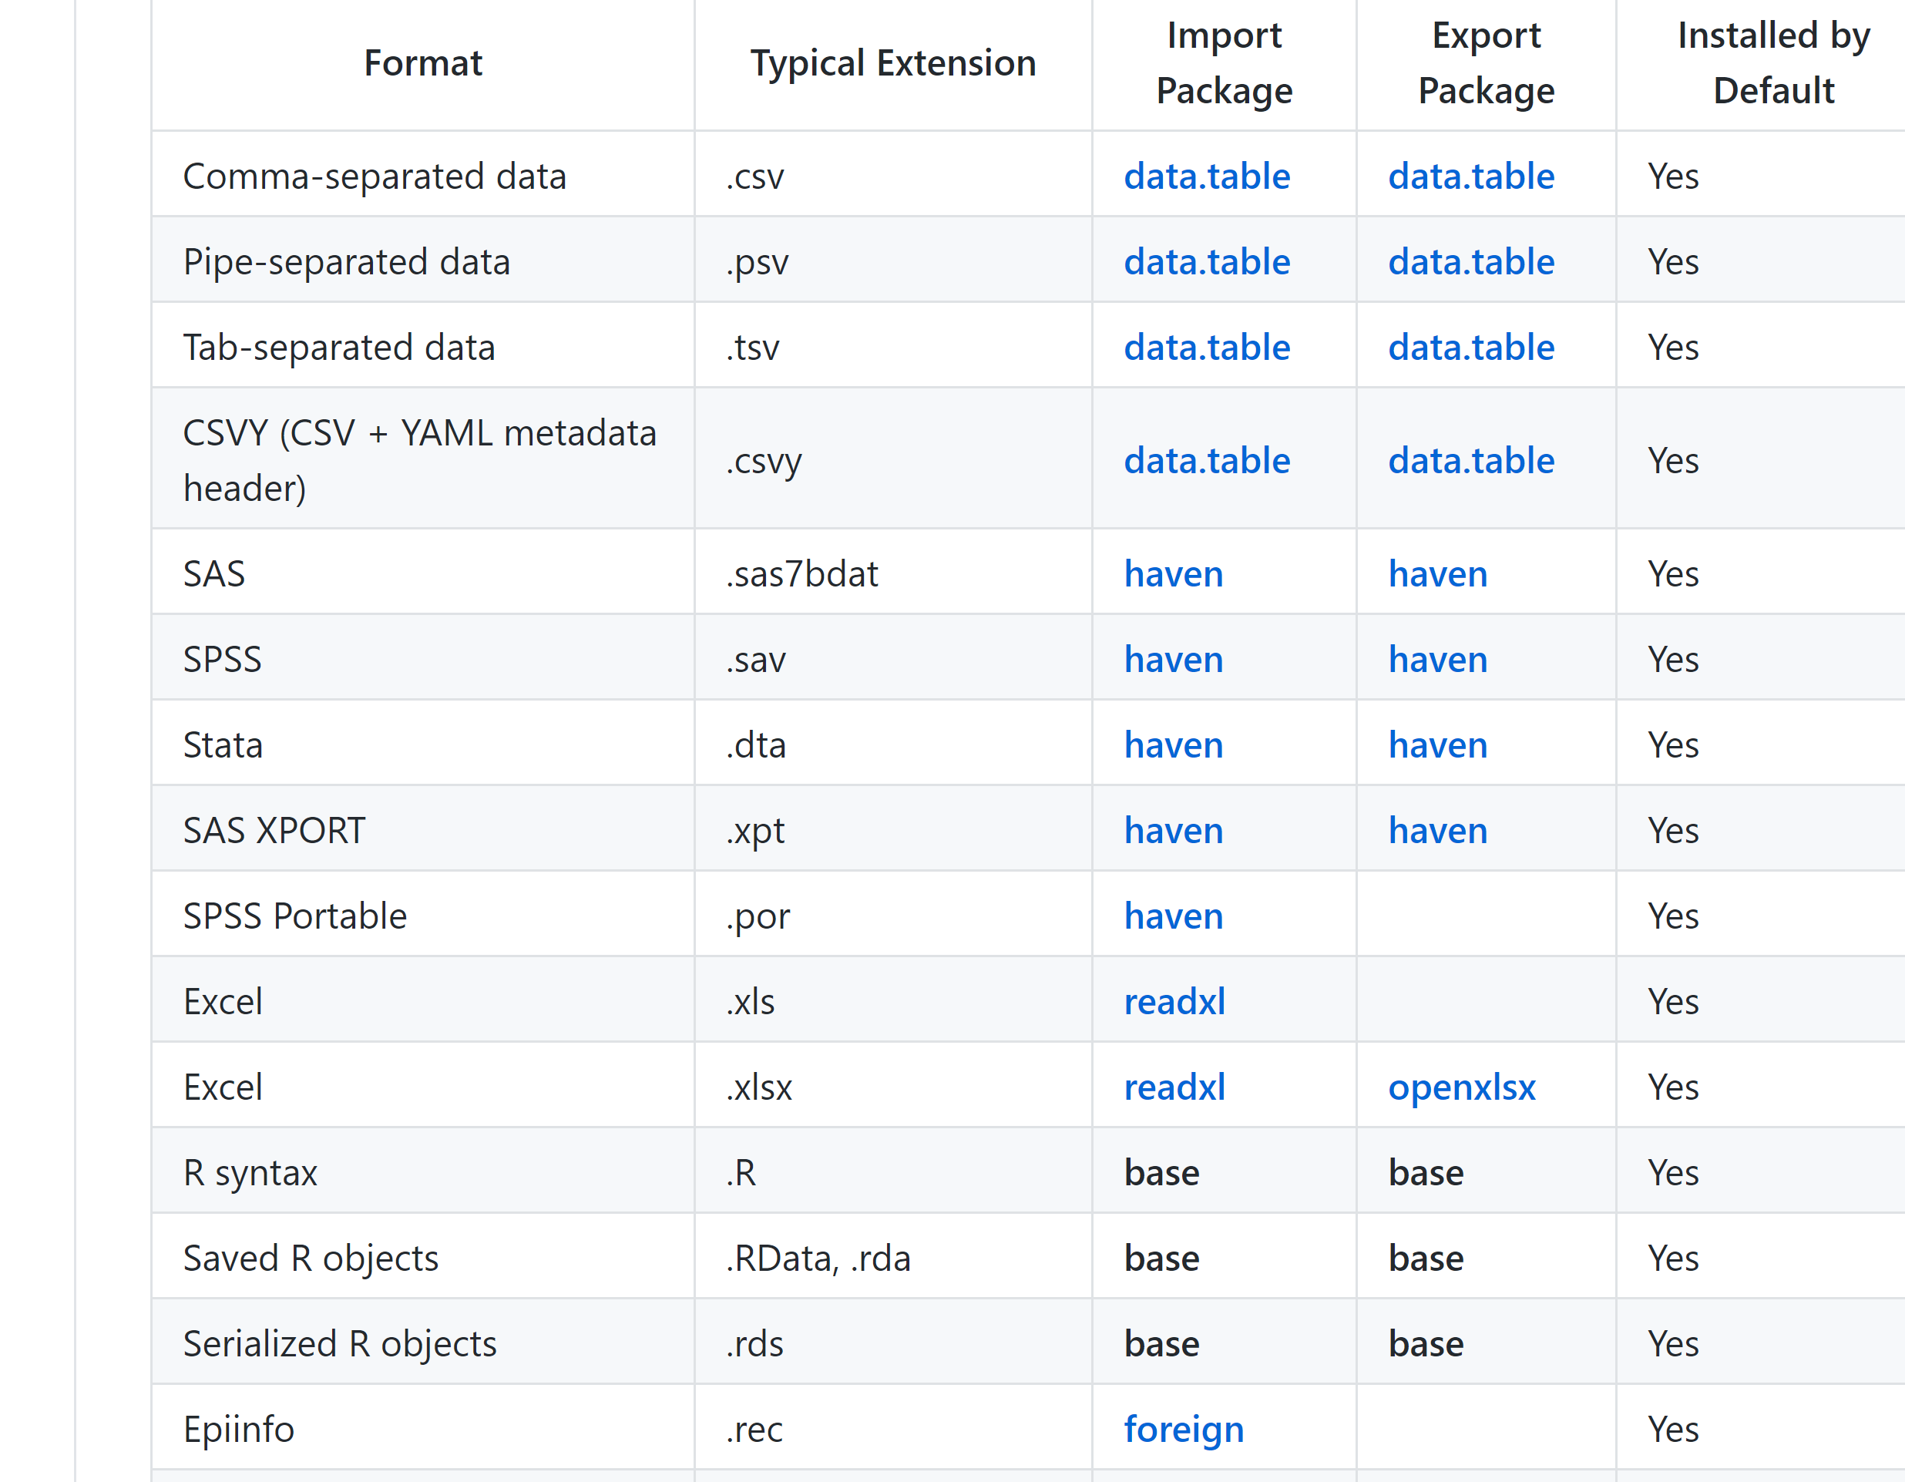


Slide 47
Lesson Goals
Get oriented to R and RStudio
Learn some fundamentals of coding
Lesson Objectives
Log in and tour RStudio Cloud
Execute code at the console
Define and use functions
Define and create objects in the environment
Load data into R and interact with a dataframe

